Slide 1
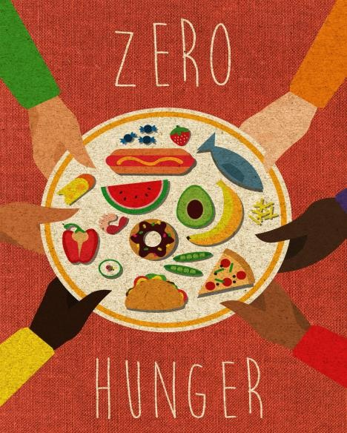
Team Name: Feasible Four
Project Name: LIFE-LEFT
(Leftovers to Lifelines)
An Innovative Food Redistribution System
SDG 1 – No poverty SDG 2 – Zero Hunger
SDG 3 – Good Health and Well-Being

Slide 2
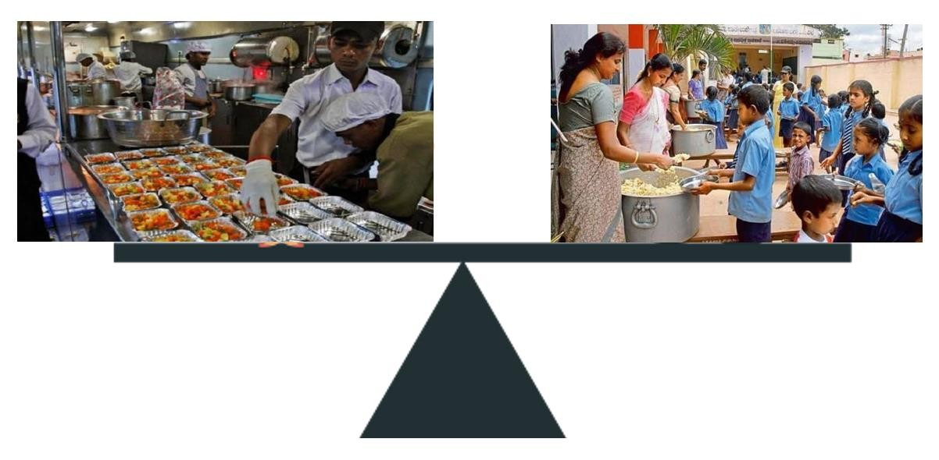
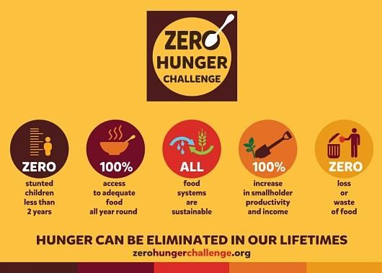
PROBLEM STATEMENT
To distribute the excess food available to the deprived people in an effective and sufficient manner by forming a network which connects both the donor and beneficent in a single platform.

Slide 3
Introduction
The population of Indian subcontinent is around 1.33 billion. Despite of these number, Statistics says that around 40% of the produced food is not consumed or poperly stored by the people.
There are 1.77 million homeless people in India, or 0.15% of the country's total population. Also it is found that there are around 9,600 child care institutions in India.
Even though there are NGO’s and other agencies, whose moto is to provide food for those homeless and institutions, the need is not fully satisfied.
These excess food produced per day, can be used to feed those people who are in need. So, here we are in digital India, where we need to find a digital way to balance, that helps to satisfy the need of deprived people.
•
•
•

Slide 4
Research Survey
REFERRED WORKS | INFERENCE
TECHNICAL APPROACH: Food Recommender Systems: Important Contributions, Challenges and Future Research Directions: Christoph Trattner, David Elsweiler | The frequently ordered food that are taken into consideration and will be used to recommend to the user while making their next or upcoming order using machine learning .
Real Time Global Positioning System (GPS) Tracking Implementation Using Android and Web Based System: R.B.Mulia, S.King, Y.H.Budiawan, L.S.Tanitama | GPS tracking system which provides real time current position information by using High Speed Downlink Packet Access (HSDPA). the tracking operation could be done between Android devices and web based system simultaneously, by which the receiver could also be used as the coordinate sender.
An intelligent model for assuring food quality in managing a multi- temperature food distribution centre: Y.P.Tsang,K.L.Choy,C.H.Wu | Finding an optimum transportation route using IOT(route planning system (IRPS)). Integrating the IOT systems, helps us to find the optimal delivery routes by minimizing the travelling distance and food spoilage rate.
BUSINESS APPROACH: An empirical study of online food delivery services from applications perspective: Venkatesa Prabu.S, Brashyam Sasikumar. | Apps for food delivery is suited for India because it saves time and people are aware of its services and operations. That implies that the food delivery solution provides its users with a highly customized experience when properly designed and improved revenue.

Slide 5
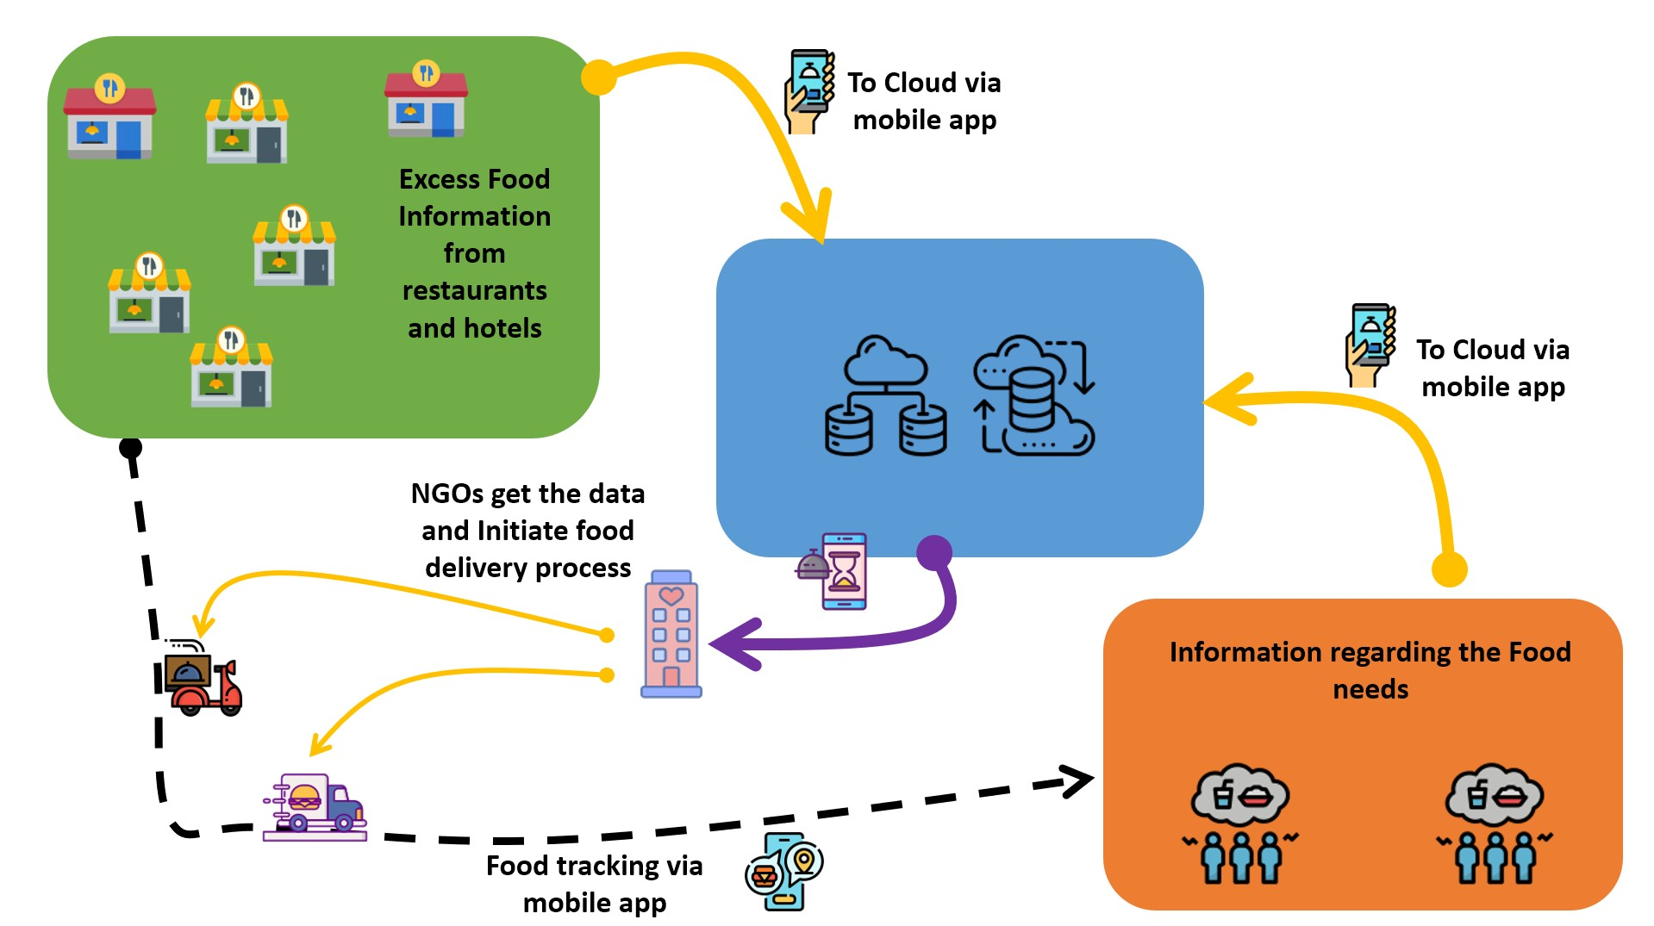
Proposed Solution

Slide 6
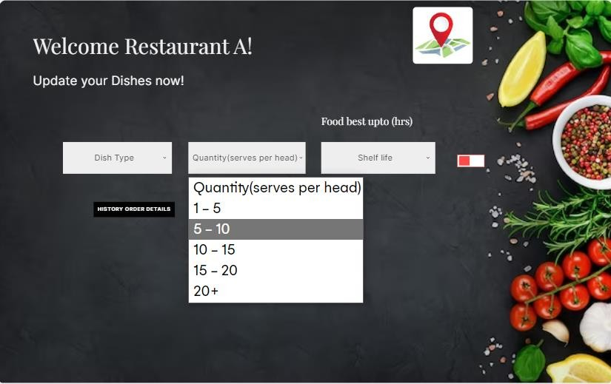
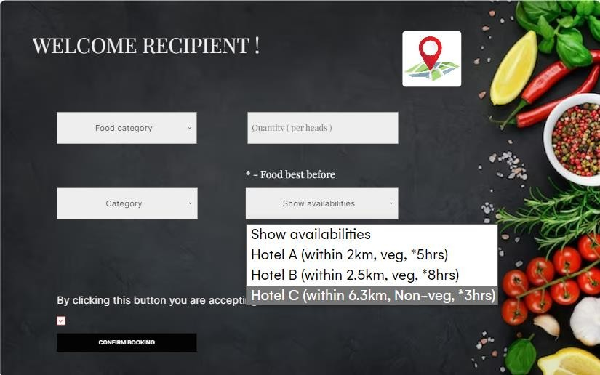
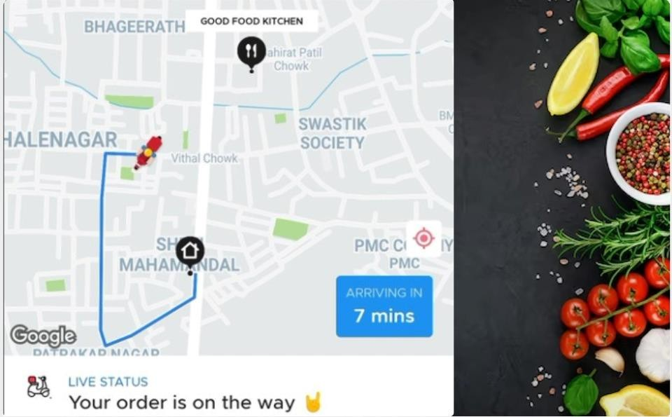
Prototype (if applicable):
Contributor
Recipient
Order Information:

Slide 7
Advantages
Our approch of the problem will act as the bridge between contributor and recipient.
This approach saves time and it is contactless. The only work of the users is to provide the valid information.
Active participation of people will help to reduce the hunger related problem in our society thus moving towards zero hunger.
DISADVANTAGES
If the user enters invalid data then entire process is collapsed as this entire process depends on the user’s data.

Slide 8
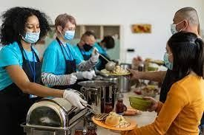
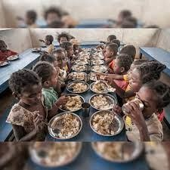
Conclusion
The main idea of our project is to make a mid link food distribution system between contributors (with excess food) and recipient (who are in need of food). Therefore, homes like child care, old age care & cancer institutes doesn’t need to directly depend on the NGO’s and general public. This system also helps to satisfy the food requirement of deprived people thus achieving the goal of “No Poverty” ,“No Hunger” and “Good Health and Well-Being”. The future scope of our project is to build an autonomous vehicle for food transportation to reduce the dependency on other bodies for food distribution.
Food redistribution system
Mid link distribution
system
Recipients
Contributors

Slide 9
References
An empirical study of online food delivery services from applications perspective:-Venkatesa Prabu.S, Brashyam Sasikumar.
Real Time Global Positioning System (GPS) Tracking Implementation Using Android and Web Based System:- R.B.Mulia, S.King, Y.H.Budiawan, L.S.Tanitama
A case analysis of a sustainable food supply chain distribution system—A multi- objective approach:- S.Validi, A.Bhattacharya, P.J.Byrne
Tracking Systems as Thinging Machine: A Case Study of a Service Company:-
Sabah Al Fedaghi, Yousef Atiyah
A Food Recommender System Considering Nutritional Information and User Preferences:- Raciel Yera Toledo, Ahmad A Alzahrani, Luis Martinez

Slide 10
Thank You

